Slide 1
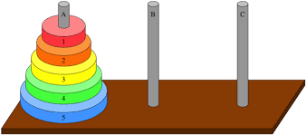
CS5413 NP-Completeness
Towers of Hanoi
Goal : Transfer all n disks from peg A to peg C

Slide 2
Rules :
- move one disk at a time
- never place larger disk above smaller one
Recursive solution :
transfer n-1 disks from A to B
move largest disk from A to C
- transfer n-1 disks from B to C

Slide 3

Total # of moves :
T(n) = 2T(n-1) + 1
Recursive relation :
T(n) = 2T(n-1) + 1
T(1) = 1
Solution by repeated substitution:
T(n) = 2(2T(n-2) + 1) + 1
= 4T(n-2) + 2 + 1
= 4(2T(n-3) + 1) + 2 +1
= 8T(n-3) + 4 + 2 + 1
…
= $2^{i}$ T(n-i) + $2^{i−1}$ + $2^{i−2}$ + … + $2^{1}$ + $2^{0}$

Slide 4

The expansion stops when
n – I = 1 => I = n – 1
T(n) = $2^{n−1}$ + $2^{n−2}$ + $2^{n−3}$ + … + $2^{1}$ + $2^{0}$
-> Geometric series
T(n) = $2^{n}$ - 1 = O($2^{n}$)

Slide 5
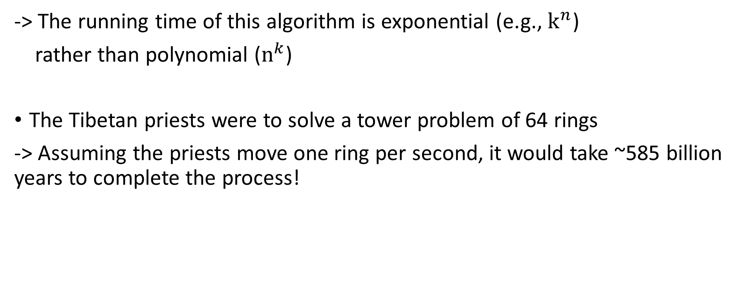
-> The running time of this algorithm is exponential (e.g., $k^{n}$)
rather than polynomial ($n^{k}$)
The Tibetan priests were to solve a tower problem of 64 rings
-> Assuming the priests move one ring per second, it would take ~585 billion years to complete the process!

Slide 6
Decision problems
Instead of linking such long running times to the size of the solution of an algorithm, we may consider only T/F or Y/N problems
– so-called “decision problem”.
Transformation of an optimization problem into an easier decision problem
- optimization problem :
“Find a shortest path between vertices u and v in a graph G.”
- Decision problem :
“Determine if there is a path between vertices u and v in a graph G shortest than k.”

Slide 7
If we have an easy way to solve the optimization problem, then we can use it to solve the decision problem.
If we show that the decision problem is hard, then we know that the optimization problem must be hard too.

Slide 8
Reasonable vs. Unreasonable
 | ft. \ n | 10 | 20 | 50 | 100 | 300
polynomial |  | 1/10000 | 1/2500 | 1/400 | 1/100 | 9/100
 |  | 1/10 | 3.2 | 5.2 | 2.8 | 28.1
Exponential |  | 1/1000 | 1 | 35.7 years | 400 trillion centuries | 75 digit number centuries
 |  | 2.8hours | 3.3trillion years | 70 digit number centuries | 185 digit number centuries | 725 digit number centuries
$$n^{2}$$
$$n^{5}$$
$$2^{n}$$
$$n^{n}$$

Slide 9
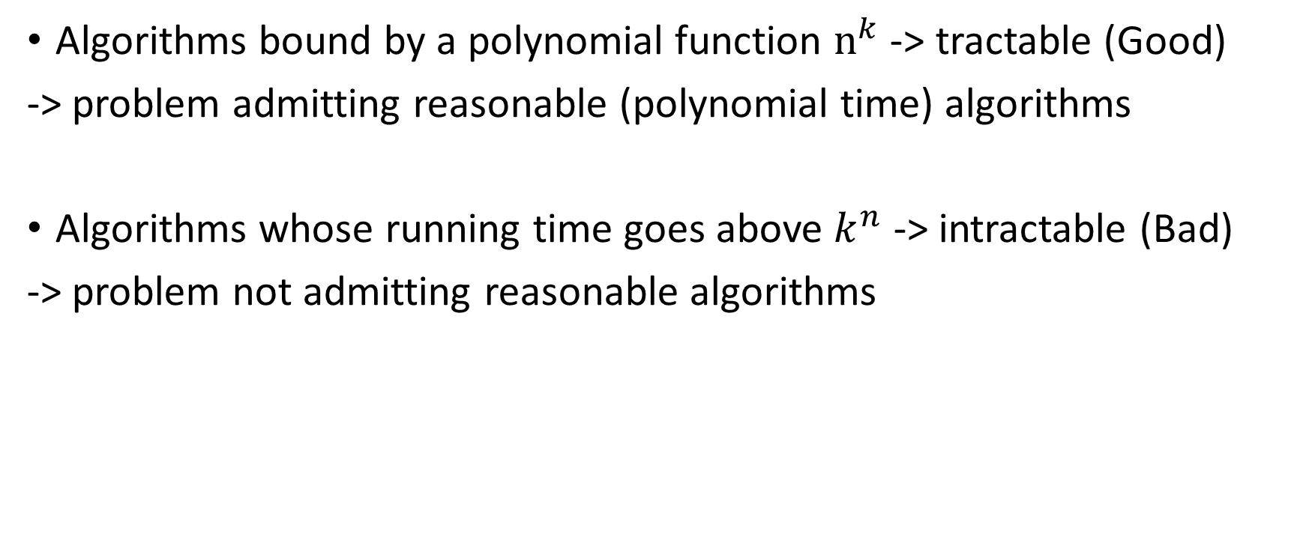
Tractable vs. Intractable
Algorithms bound by a polynomial function $n^{k}$ -> tractable (Good)
-> problem admitting reasonable (polynomial time) algorithms
Algorithms whose running time goes above $k^{n}$ -> intractable (Bad)
-> problem not admitting reasonable algorithms

Slide 10
Speedup of computers (HW) is insignificant (≈ a constant)
compared to exponential running time growth
Such problem are called NPC (NP-complete) problems (~1000 problems)

Slide 11
Traveling salesman problem (TSP)
A traveling salesperson needs to visit n cities
Is there a route of at most d length?
-> Decision problem
cf. optimization-version is to find a shortest cycle visiting all vertices once in a weighted graph

Slide 12
naive solutions take n! time in worst-case, when n is the number of edges of the graph
no polynomial-time algorithms are known
-> TSP is an NP-complete problem
cf. Longest path problem between A and B in a weighted graph is also NP-complete

Slide 13
Coloring problem (COLOR)
3-color : given a planer map, can it be colored using 3 colors so that no adjacent regions have the same color?
No. Impossible to color Nevada & bordering states by using 3-colors
-> any map can be 4-colored
Maps that contain no points that are the junctions of an odd number of states can be 2-colored
-> No polynomial algorithms are known to determine whether a map can be 3-colored : an NP-complete problem

Slide 14
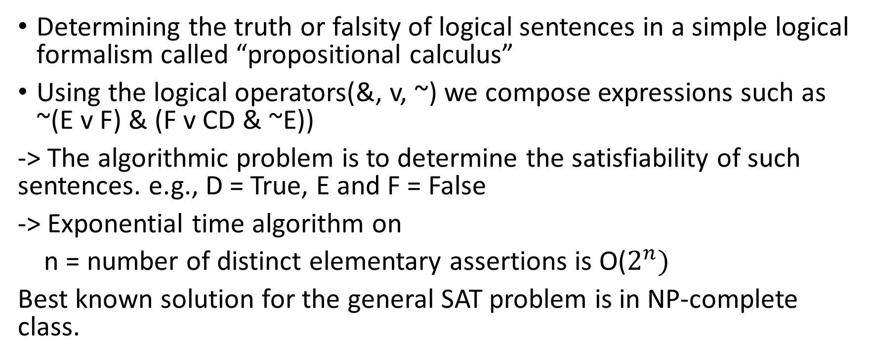
Satisfiability (SAT)
Determining the truth or falsity of logical sentences in a simple logical formalism called “propositional calculus”
Using the logical operators(&, v, ~) we compose expressions such as ~(E v F) & (F v CD & ~E))
-> The algorithmic problem is to determine the satisfiability of such sentences. e.g., D = True, E and F = False
-> Exponential time algorithm on
n = number of distinct elementary assertions is O($2^{n})$
Best known solution for the general SAT problem is in NP-complete class.

Slide 15
CLIQUE
Given n people and their pairwise relationships,
is there a group of s people (called “clique”) such that every pair in the group knows each other?
people : a, b, c, …., k
friendships : (a, e), (a, f), ….
clique size : s = 4?
Yes, e.g., {b, d, I, h} is a “certificate”.

Slide 16
P complexity class
Definition of P :
set of all decision problems solvable in polynomial time on real computers
Ex :
- shortest path : Is the shortest path between u and v in a graph shorter than k?
- RelPrime : are the integers x and y relatively prime? Yes : (x, y) = (34, 39)
- LCS : given two strings x and y, is the length of their longest common subsequence > k?
Yes : (x, y, k) = (“CGTTAG”, “GGTACG”, 3)

Slide 17
NP
Definition: Set of all decision problems solvable in polynomial time on a non-deterministic computer.
An alternative definition:
Set of all decision problems w, efficient verification algorithms.
- efficient means polynomial # of steps on deterministic time
- verifier : algorithm for decision problem w/ extra input

Slide 18
why doesn’t this imply that all problems in NP can be solved efficiently?
-> need to know certificate ahead of time
Real computers can simulate by guessing all possible certificates and verifying
Naïve simulation takes exponential time unless lucky

Slide 19
NP-Completeness
Informal definition of NP-hard class:
A problem w/ the property that if it can be solved efficiently, then it can be used as a subroutine to solve any other problem in NP efficiently.
-> NP-complete problems are NP problems that are NP-hard.
->“Hardest computational problems in NP”.
Each NPC problem’s nature is tightly coupled to all the others.
-> Finding a polynomial time algorithms for one NPC problem would automatically yield a polynomial time algorithm for all NP problems.

Slide 20
-> proving that one NPC problem has an exponential lower bound would automatically prove that all other NP-complete problems have exponential lower bounds.

Slide 21
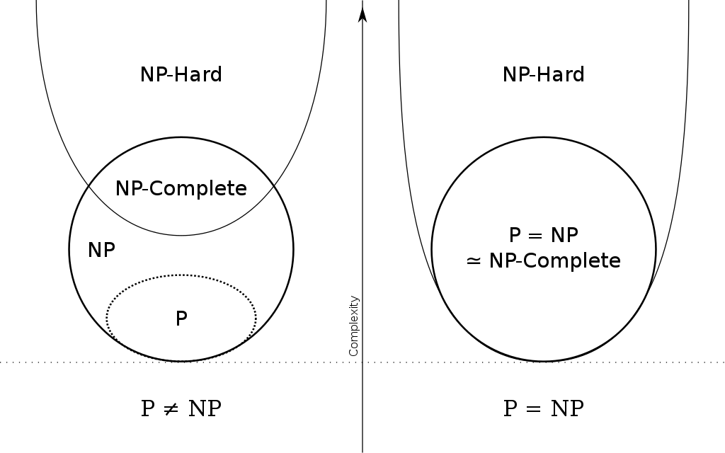

Slide 22
Reducibility
Polynomial time Reduction:
given two problems, it is an algorithm running in polynomial time that reduces one problem to the other such that
- given input X to the first and asking for a yes/no answer
- transform X into input Y to the second problem such that its answer matches the answer of the first problem.

Slide 23
Reduction is a general technique for showing that one problem is harder (easier) than another
- for problems A and B, we can often show : if A can be solved efficiently then so can B.
- in such case, we say B reduces to A (B is “easier” than A, or B cannot be “worse” than A)

Slide 24
NP-complete problem A:
- It is NP problem
- For any NP problem,
B can be polynomially reduced to A.

